Slide 1


Using Piecewise Support Vector Quantile Regression
Automatic Change-Point Detection
Authors: Jing-Rung Yu, Sheng-Yu Tsai, Chun-Yen Tsai, Donald Lien
Speaker: Sheng-Yu Tsai (Justin)
National Chi Nan University, Taiwan

Slide 2
Outline
Motivations
Framework
Preliminary Experiments
Conclusions

Slide 3
Pattern Change Detection (PCD)
Notes:
For example, here we have the S&P 500 trendline. You can see several patterns marked by the red lines. But before we can detect these patterns, we need to find the change points first.

Slide 4
PCD Statistical Methods (Gupta, Wadhvani, & Rasool, 2024)
1. Statistical Methods
CUSUM, PLR
2. Bayesian Methods
BCPA, BOCD
3. Time-Frequency Methods
WCPD、SDCPD
4. Machine Learning Methods
OC-SVM、LSTM
5. Hybrid Methods
LSCUSUM、Dual-LSTM
Notes:
1. Statistical Methods: CUSUM、Piecewise linear regression (PLT)、KCPD、KLIEP、uLSIF
2. Bayesian Methods: BCPA、BOCD、BCPD-NIG
3. Time-Frequency Methods: WCPD、SDCPD
4. Machine Learning Methods: One-Class SVM (OC-SVM)、Convolutional Neural Networks (CNN)、Long Short-Term Memory (LSTM)
Hybrid Methods combine the strengths of various techniques
5. Hybrid Methods: LSCUSUM、Dual-LSTM
But there is no single methods that can fit every sequential data.
The performance highly depends on the characteristics of dataset.

Slide 5
PCD Statistical Methods (Gupta, Wadhvani, & Rasool, 2024)
1. Statistical Methods
2. Bayesian Methods
The performance depends on
the characteristics of datasets
3. Time-Frequency Methods
4. Machine Learning Methods
5. Hybrid Methods
Notes:
1. Statistical Methods: CUSUM、Piecewise linear regression (PLT)、KCPD、KLIEP、uLSIF
2. Bayesian Methods: BCPA、BOCD、BCPD-NIG
3. Time-Frequency Methods: WCPD、SDCPD
4. Machine Learning Methods: One-Class SVM (OC-SVM)、Convolutional Neural Networks (CNN)、Long Short-Term Memory (LSTM)
Hybrid Methods combine the strengths of various techniques
5. Hybrid Methods: LSCUSUM、Dual-LSTM
But there is no single methods that can fit every sequential data.
The performance highly depends on the characteristics of dataset.

Slide 6
PCD Statistical Methods (Gupta, Wadhvani, & Rasool, 2024)
1. Statistical Methods
2. Bayesian Methods
3. Time-Frequency Methods
4. Machine Learning Methods
5. Hybrid Methods
Often outperform others!
Notes:
But Hybrid Methods often outperform than others by accuracy and versatility

Slide 7
Key Challenges (Gupta, Wadhvani, & Rasool, 2024)
Detecting multiple change-points
Handling high-dimensional or missing data
Processing large datasets efficiently
Note: Prediction bands can provide valuable, actionable information

Slide 8
Key Challenges (Gupta, Wadhvani, & Rasool, 2024)
Detecting multiple change-points
Handling high-dimensional or missing data
Processing large datasets efficiently
Prediction bands

Slide 9
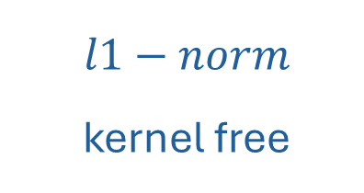
PSVQR Framework
1
2
3
Support Vector Regression
Piecewise Linear Model
Quantile Loss Function
$l1−norm$
kernel free
Piecewise regression
Detect multiple CP
Different quantile tau
Provide prediction intervals

Slide 10
PSVQR Framework
Multiple Objective Programming
Support Vector Regression
Piecewise Linear Model
Quantile Loss Function

Slide 11
Key Features
Multiple Objective Programming
Support Vector Regression
Piecewise Linear Model
Quantile Loss Function
Robust to Noise or Outliers
Multiple Change Point Detection
Interval Prediction

Slide 12

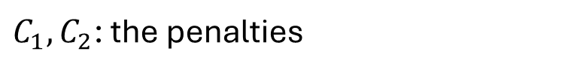


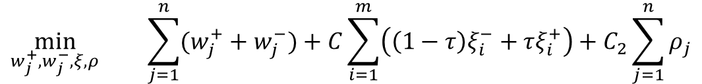
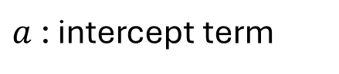
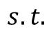
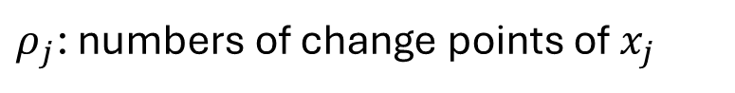
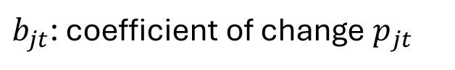
The Proposed Model
l1-norm
Quantile loss
Change Point
$$\min_{w_{j}^{+},w_{j}^{−}, ξ, ρ}{\sum_{j=1}^{n}{(w_{j}^{+}+w_{j}^{−})}+C\sum_{i=1}^{m}{\left(\left(1−τ\right)ξ_{i}^{−}+τξ_{i}^{+}\right)}+C_{2}\sum_{j=1}^{n}{ρ_{j}}}$$
Derived from SVR
$$y_{i}−(a+\sum_{j=1}^{n}{\left(w_{j}^{+}−w_{j}^{−}\right)x_{ij}+}\sum_{j=1}^{n}{\sum_{t=1}^{m}{\left(b_{jt}^{+}−b_{jt}^{−}\right)\left(\left|x_{ij}−p_{jt}\right|+x_{ij}−p_{jt}\right)\text{/2})}≤ε+ξ_{i}^{+}}$$
$$s.t.$$
Piecewise Terms
$$(a+\sum_{j=1}^{n}{\left(w_{j}^{+}−w_{j}^{−}\right)x_{ij}+}\sum_{j=1}^{n}{\sum_{t=1}^{m}{\left(b_{jt}^{+}−b_{jt}^{−}\right)\left(\left|x_{ij}−p_{jt}\right|+x_{ij}−p_{jt}\right)\text{/2}})−y_{i}≤ε+ξ_{i}^{−}}$$
$w_{j}$: the hyperplane weight vector
$a$: intercept term
$m$: the size of sliding window
$ρ_{j}$: numbers of change points of $x_{j}$
$ε$: the $ε$-insensitive tube width
$b_{jt}$: coefficient of change $p_{jt}$
$C_{1},C_{2}$: the penalties
$ξ_{i}$: residuals outside the $ε$-insensitive tube

Slide 13
Experiment Design
Prediction y:
price
Dataset: S&P 500 From 2024/07/18 to 2025/07/22
PSVQR-f1: use 1 feature (index)
Features:
Sequential Index
VIX (Volatility Index)
PSVQR-f2: use 2 features (index, VIX)
Input data
PSVQR-1f
1~256
257
MAPE
train
test
PSVQR-2f
train
test
RMSE
Z-score Standardization
train
test
ARIMA
64~319
320
NSE
Data
Model
One-Step Ahead
Measurement

Slide 14
Prediction Results (Using Index)
Model | MAPE | RMSE | NSE
ARIMA | 0.6023 | 0.1815 | 0.8093
PSVQR-1f, tau=0.1 | 1.9936 | 0.3265 | 0.5620
PSVQR-1f, tau=0.3 | 0.8064 | 0.2530 | 0.7098
PSVQR-1f, tau=0.5 | 1.7960 | 0.2454 | 0.7255
PSVQR-1f, tau=0.7 | 0.4981 | 0.2524 | 0.7300
PSVQR-1f, tau=0.9 | 0.4769 | 0.3039 | 0.8183
Features:
sequential index
Prediction y:
price

Slide 15
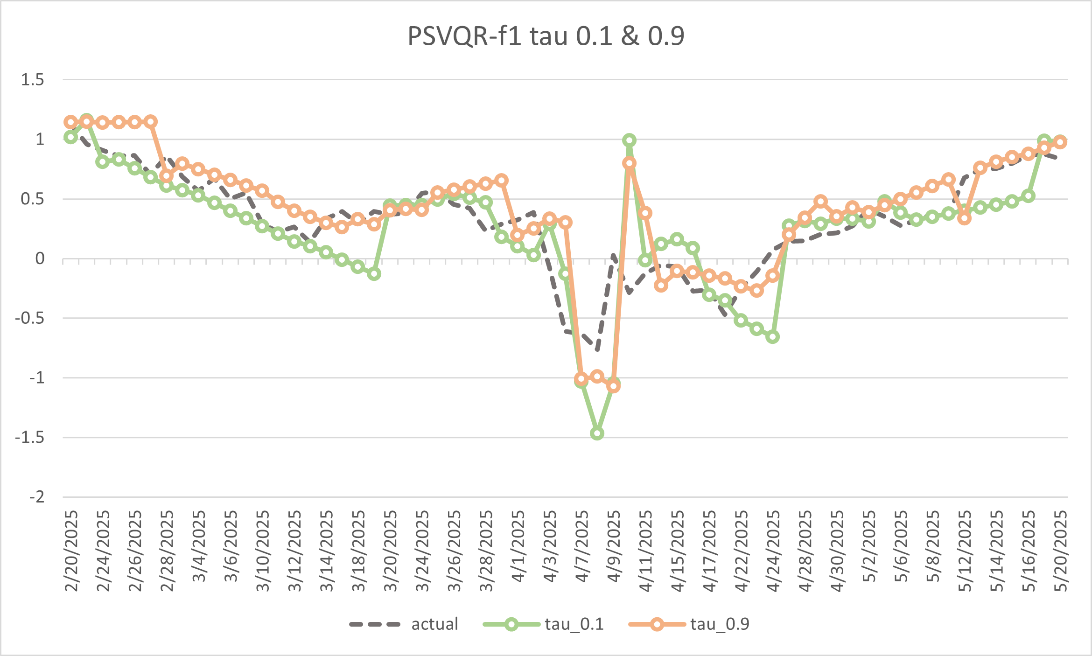
Prediction Intervals (PSVQR-f1 tau=0.1, 0.9)
Quantile Crossing Problem

Slide 16
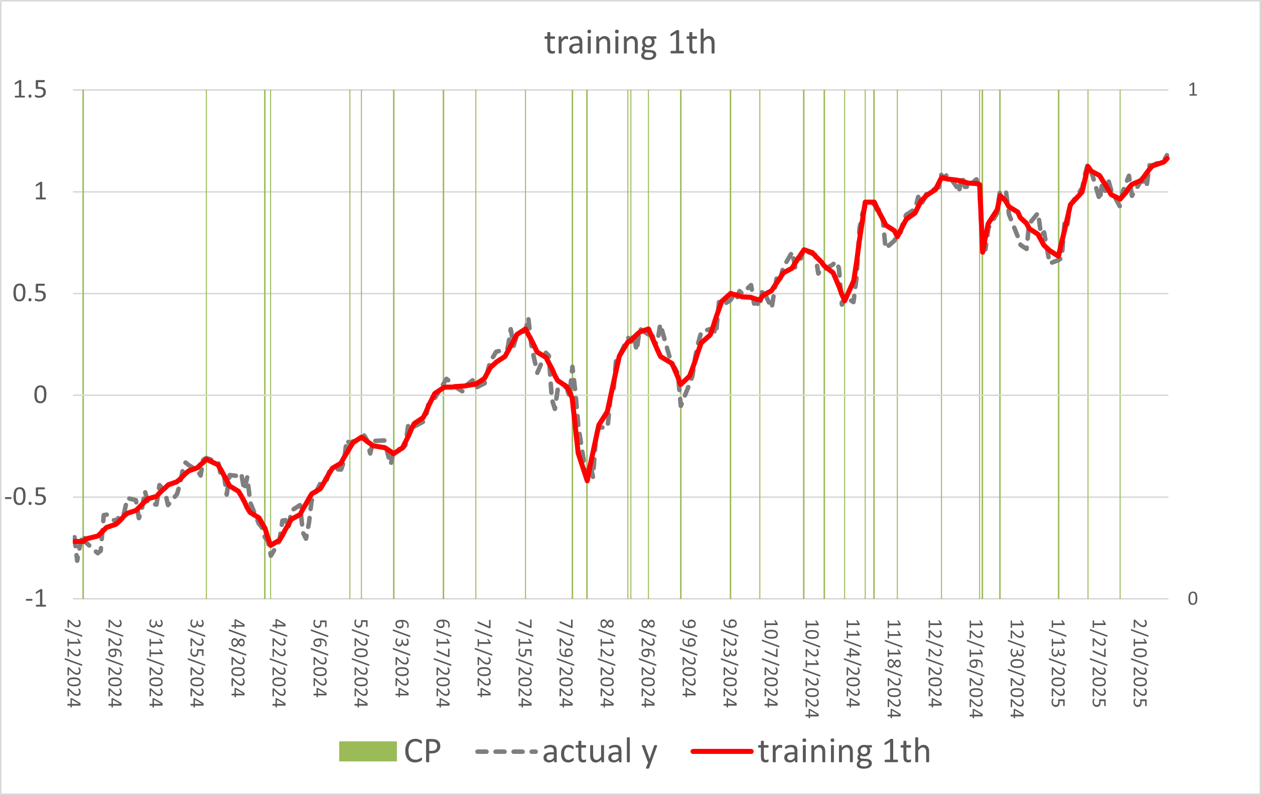
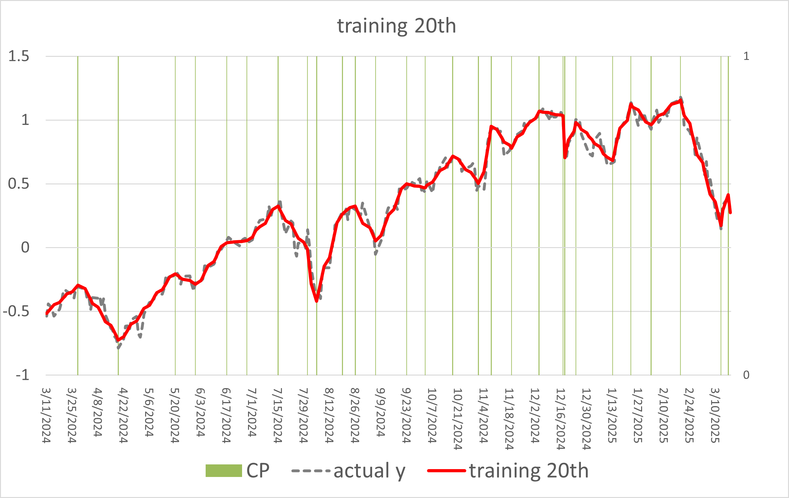
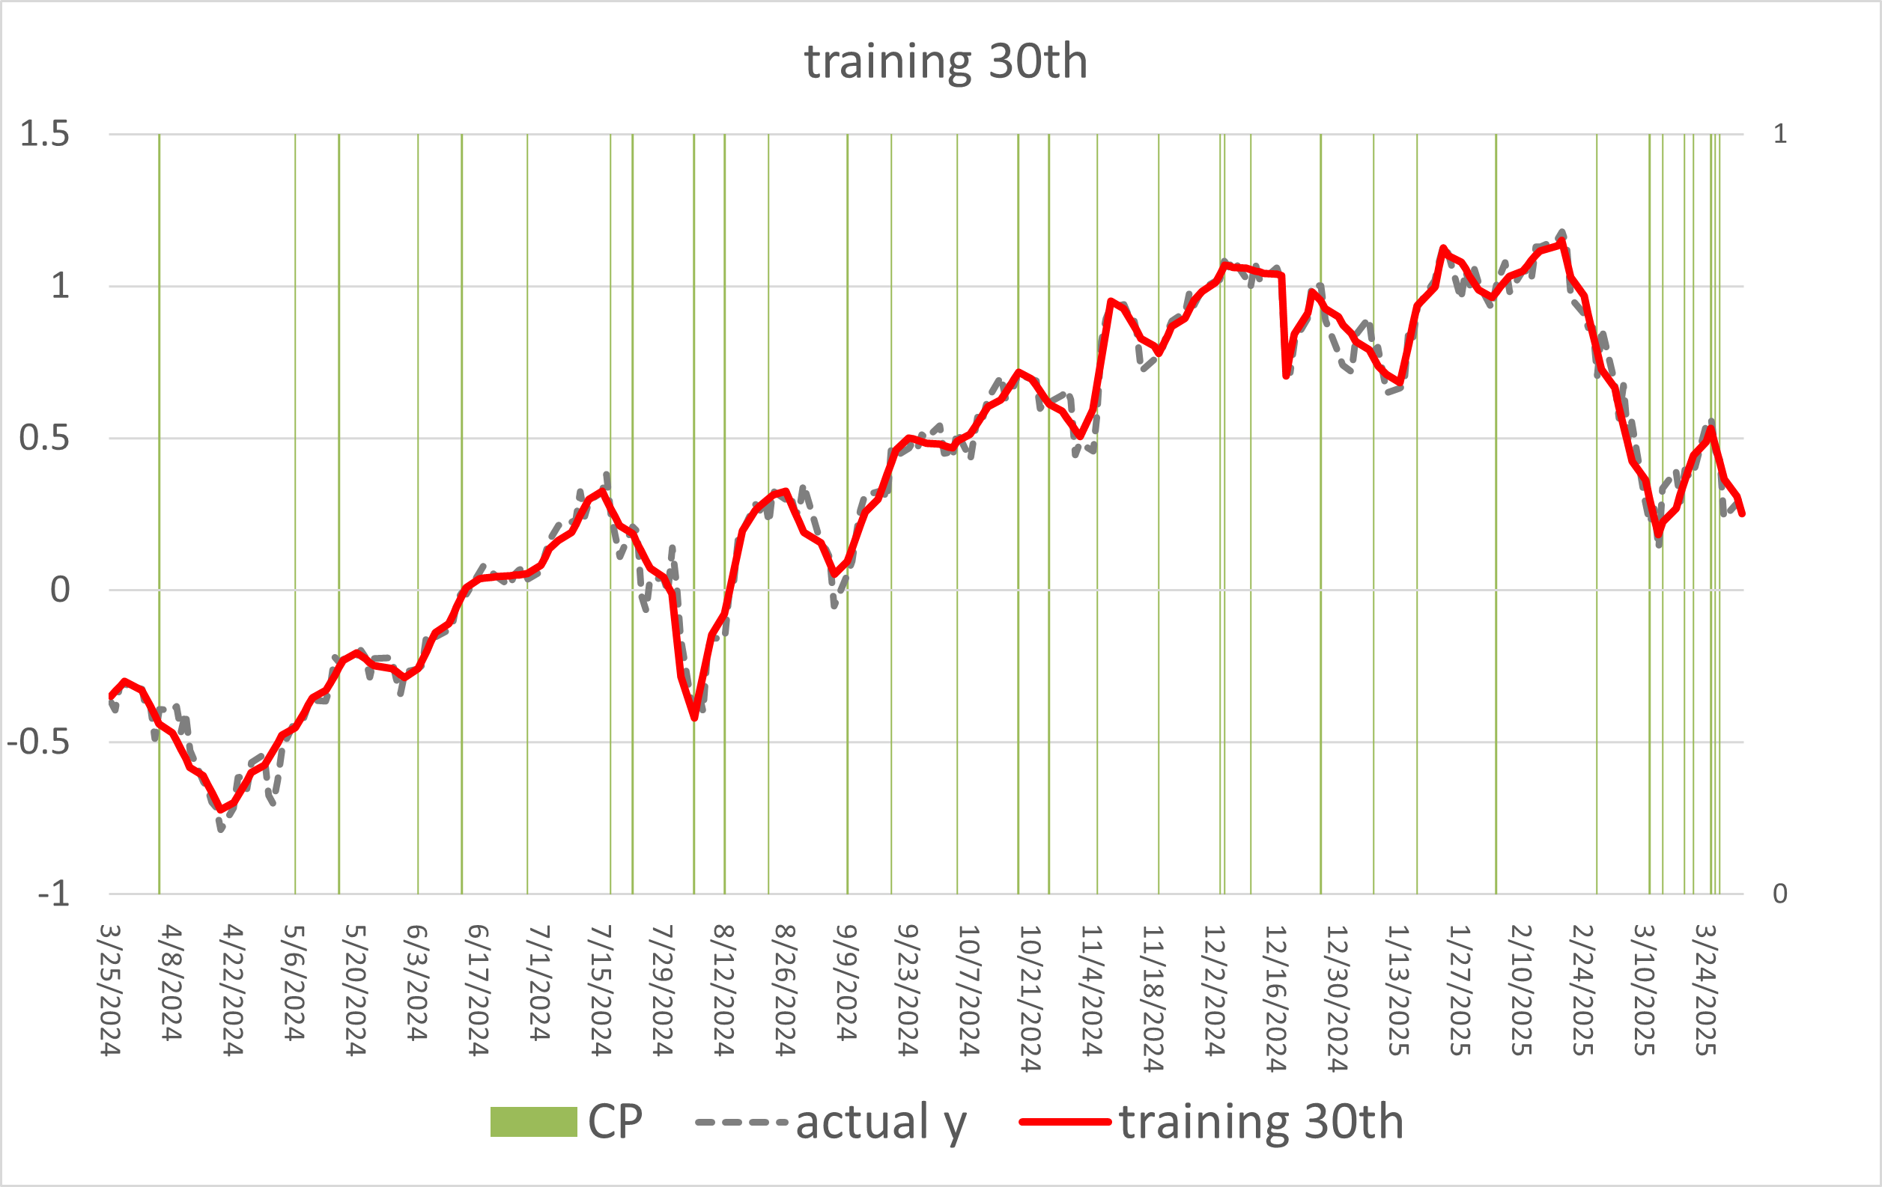
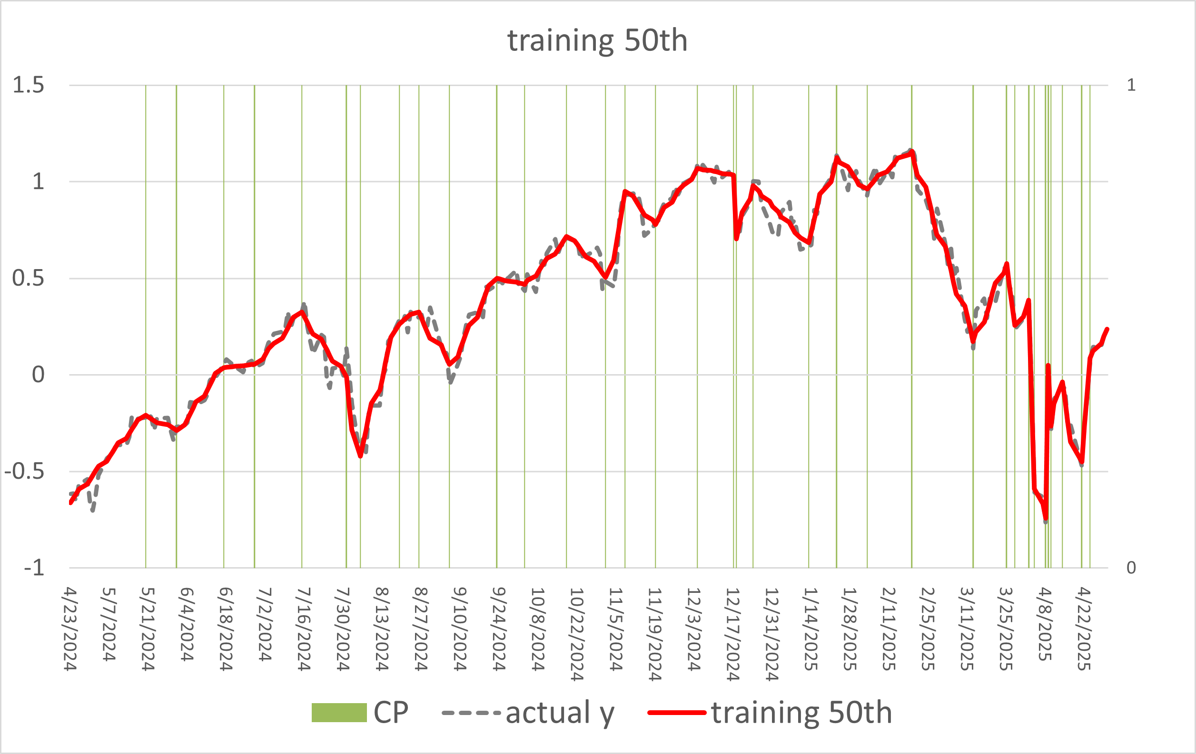
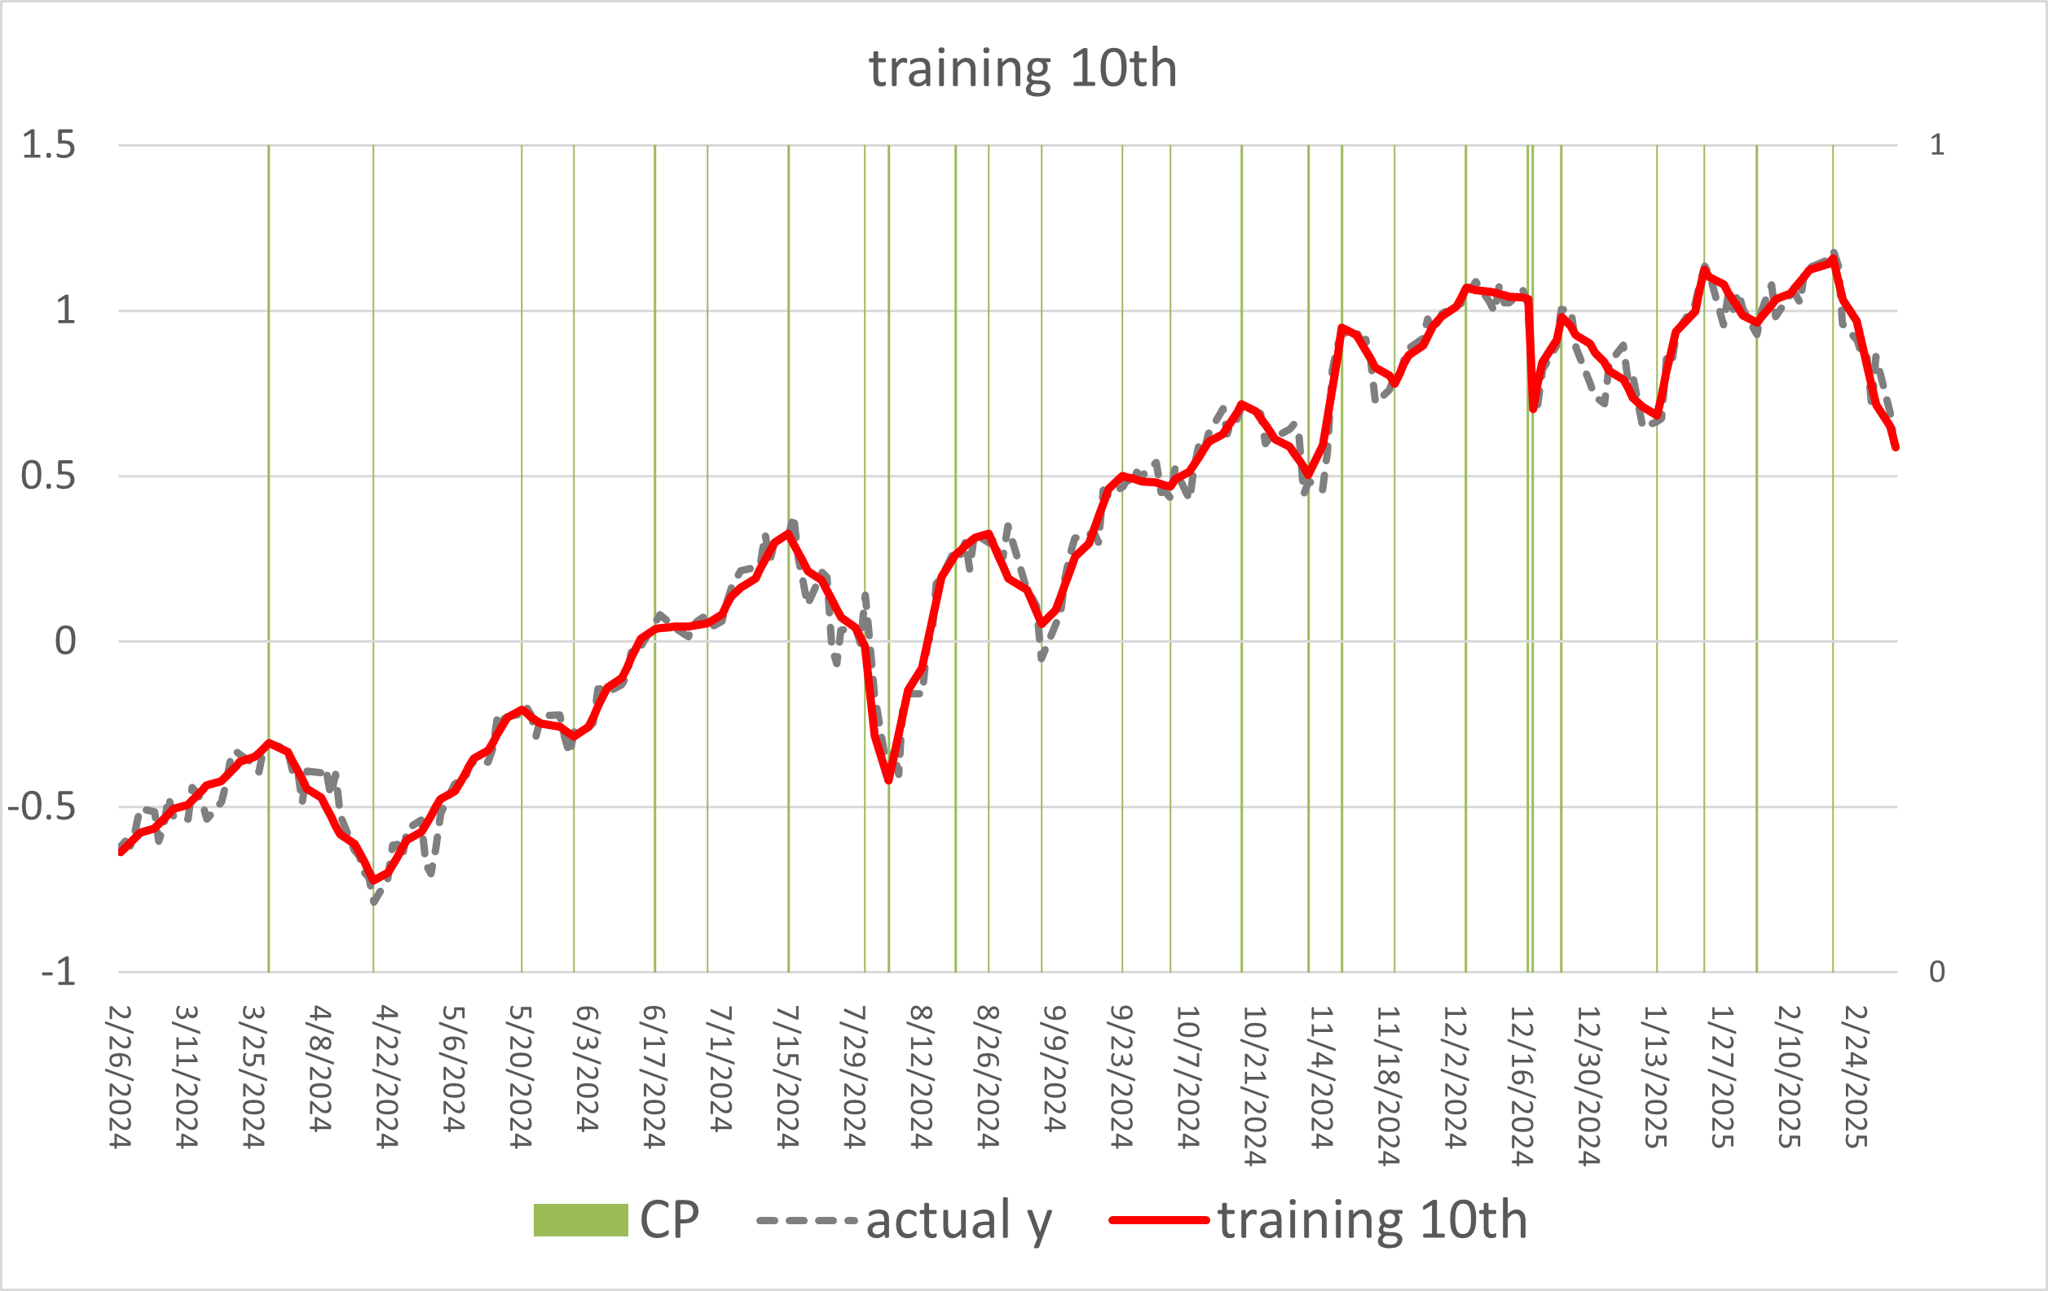
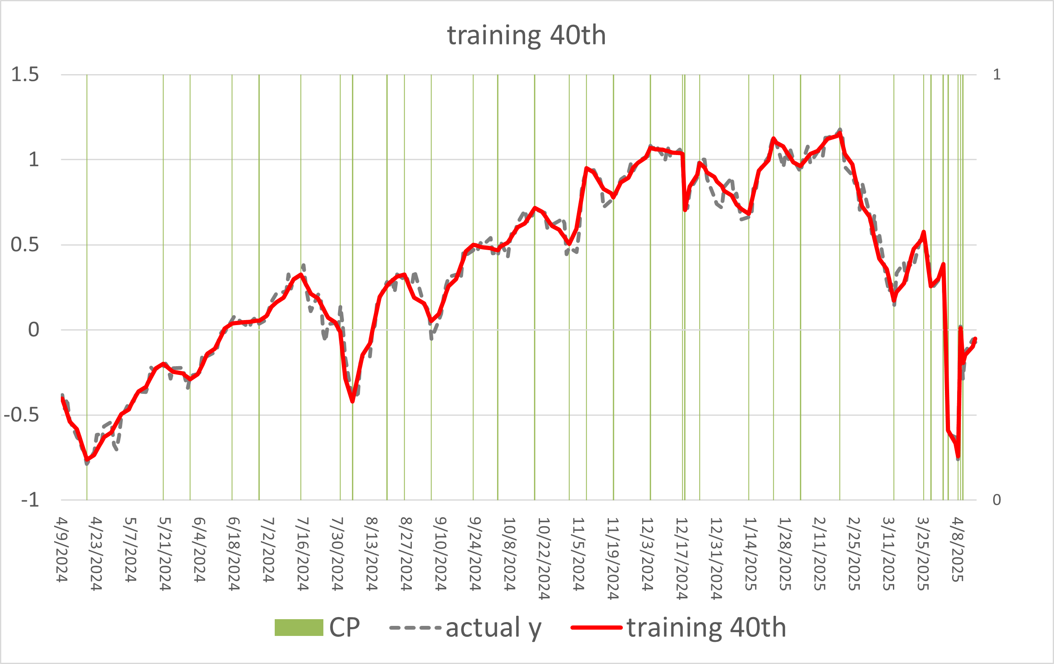
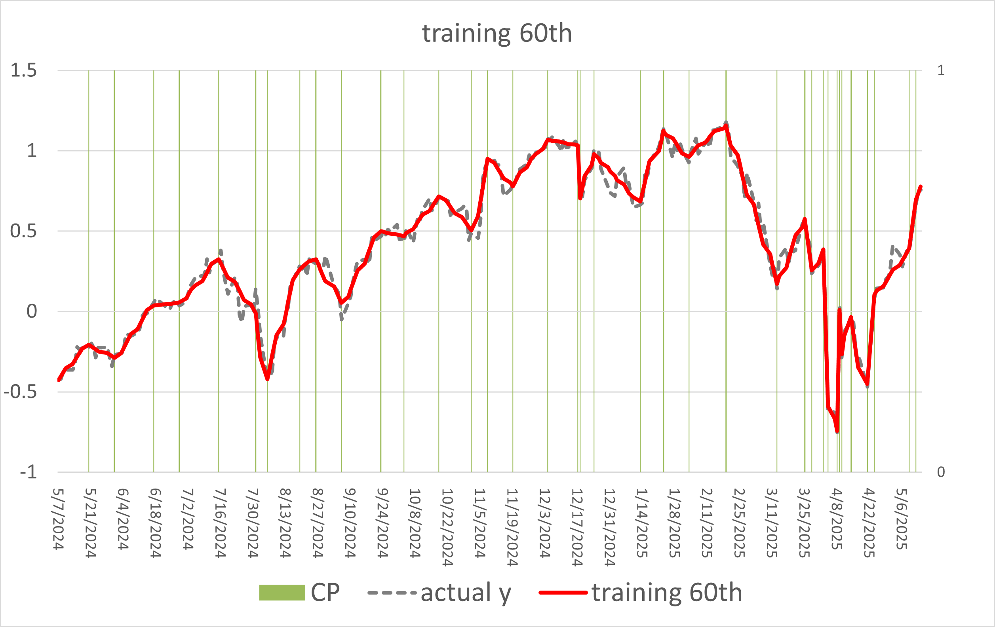
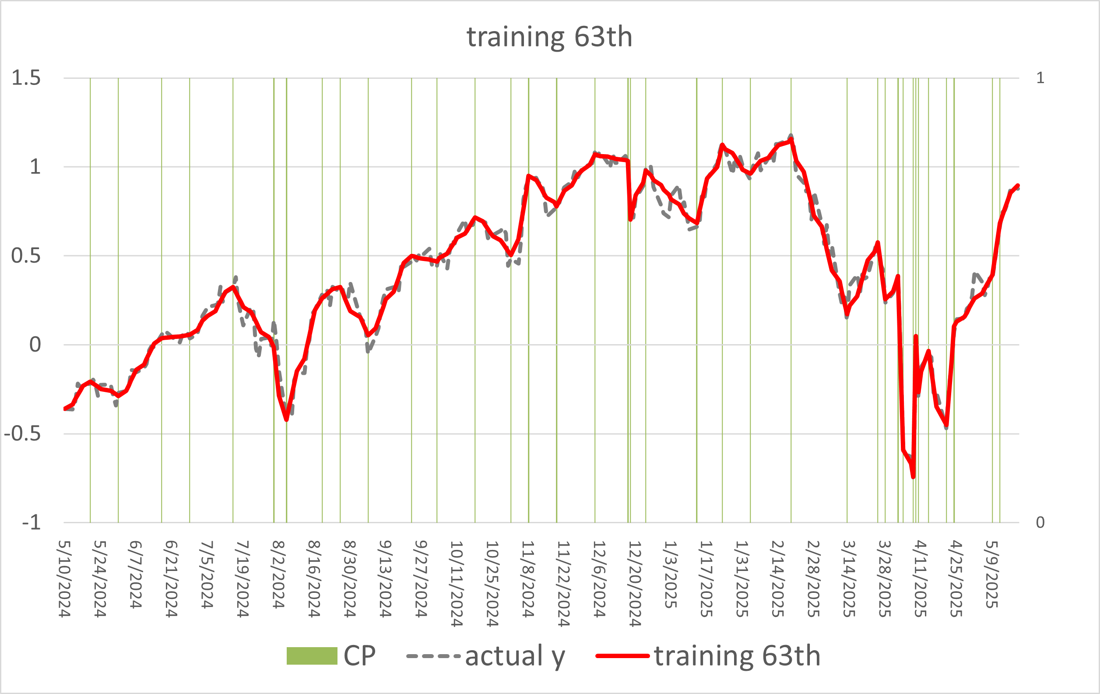
CPD Results (PSVQR-f1 tau=0.5)

Slide 17
Prediction Results (Using Index and VIX)
Model | MAPE | RMSE | NSE
ARIMA | 0.6023 | 0.1815 | 0.8093
PSVQR-2f, tau=0.1 | 0.9996 | 0.1399 | 0.8981
PSVQR-2f, tau=0.3 | 0.3770 | 0.1419 | 0.8994
PSVQR-2f, tau=0.5 | 0.9267 | 0.1520 | 0.8786
PSVQR-2f, tau=0.7 | 0.3982 | 0.1549 | 0.8667
PSVQR-2f, tau=0.9 | 1.059 | 0.1786 | 0.8450
Features:
sequential index
VIX (Volatility Index)
Prediction y:
price

Slide 18
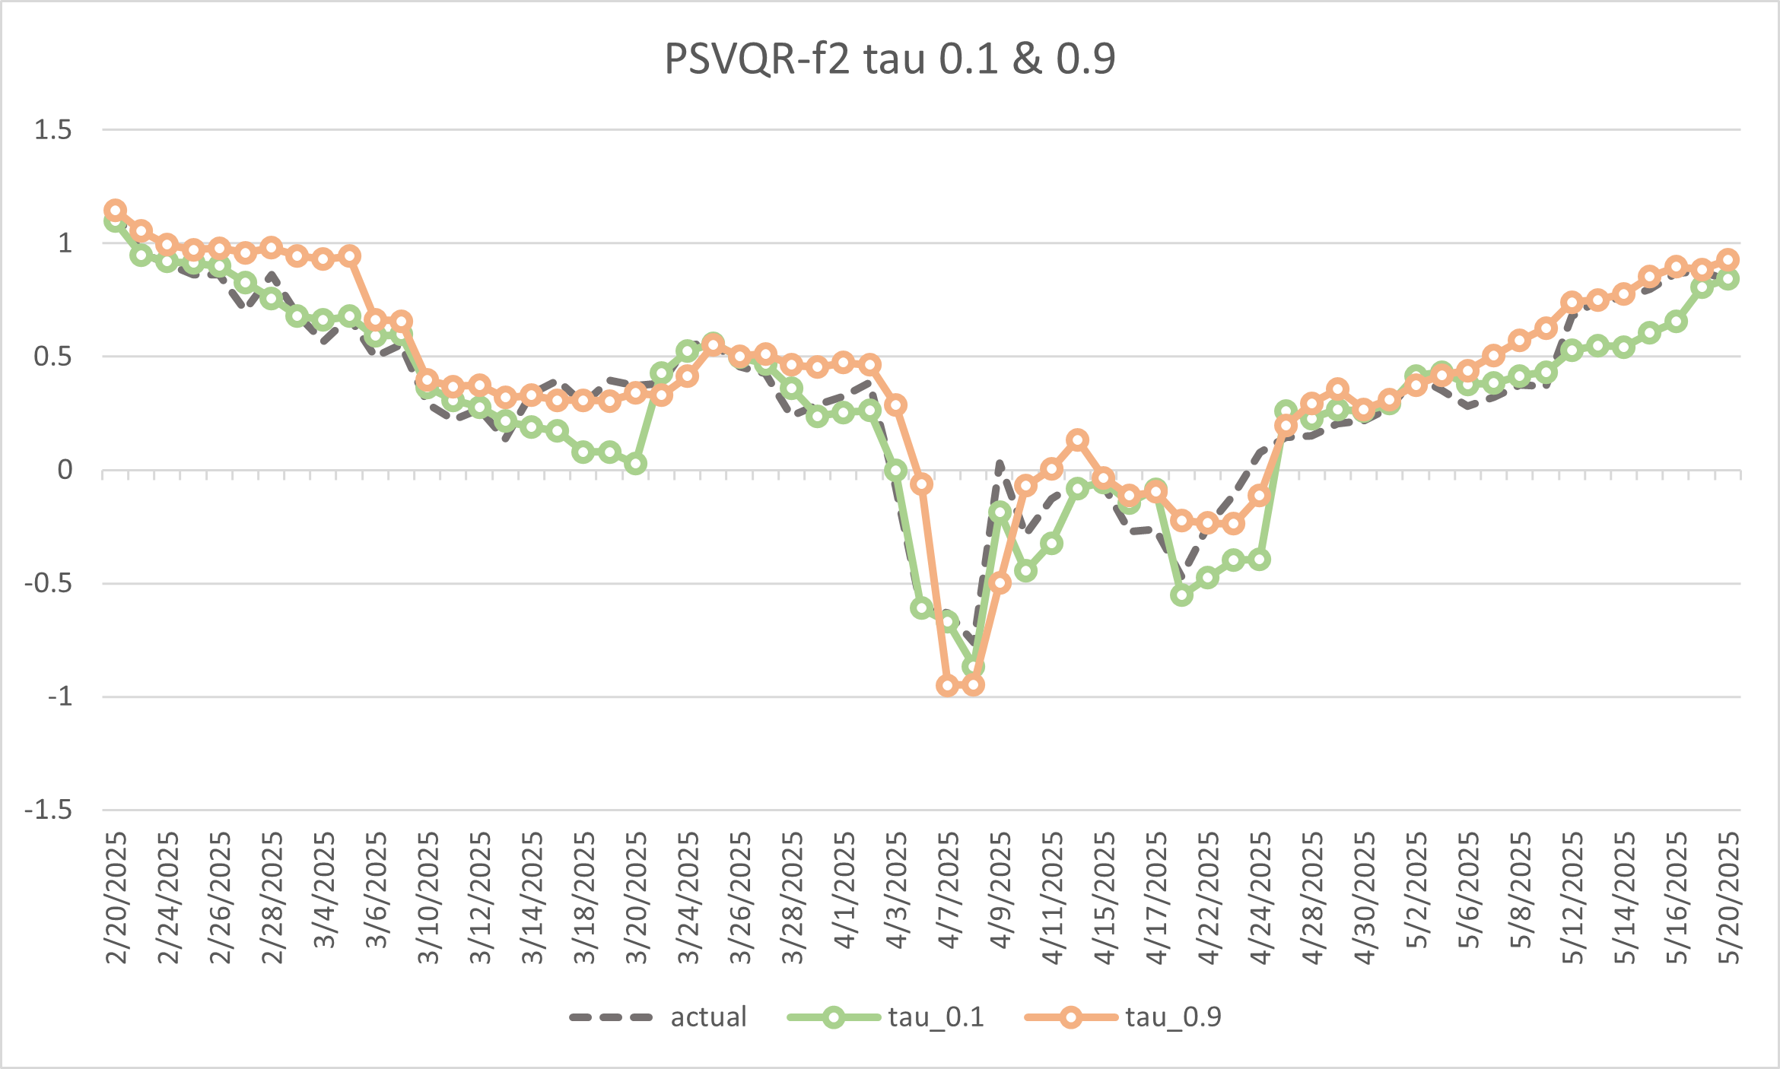
Prediction Intervals (PSVQR-f2 tau=0.1, 0.9)
Quantile Crossing Problem

Slide 19
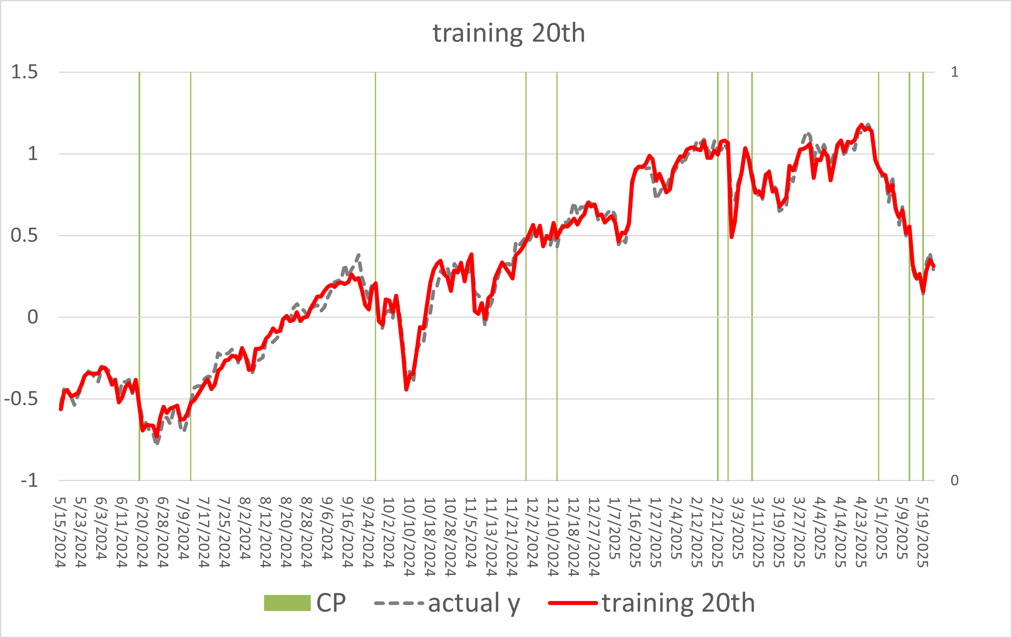
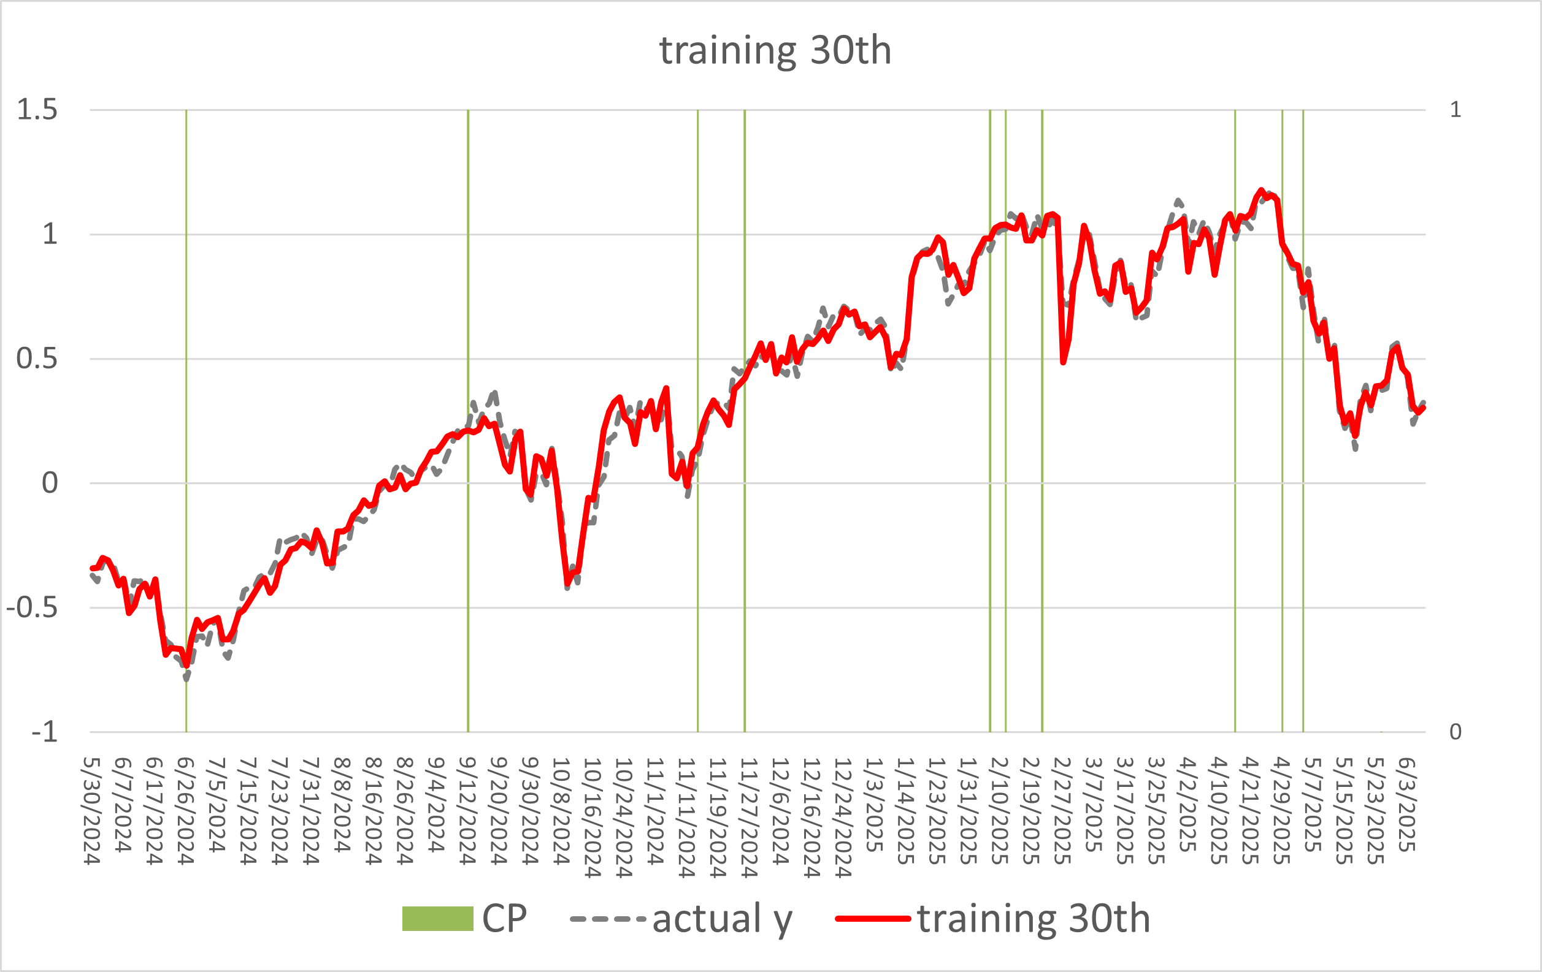
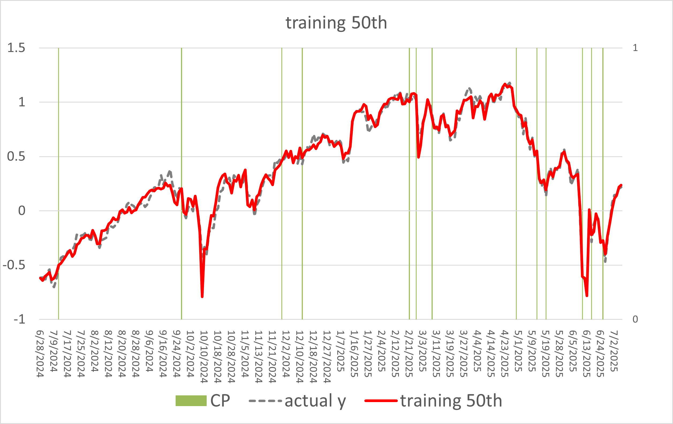
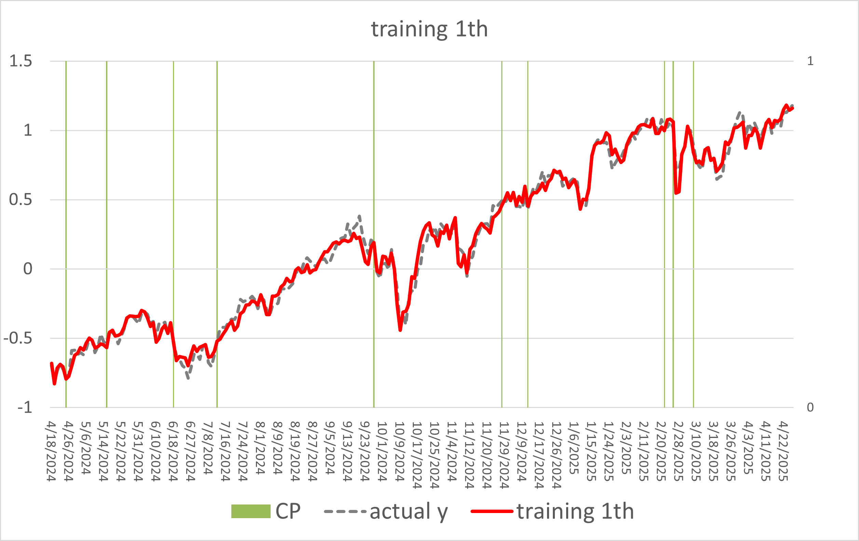
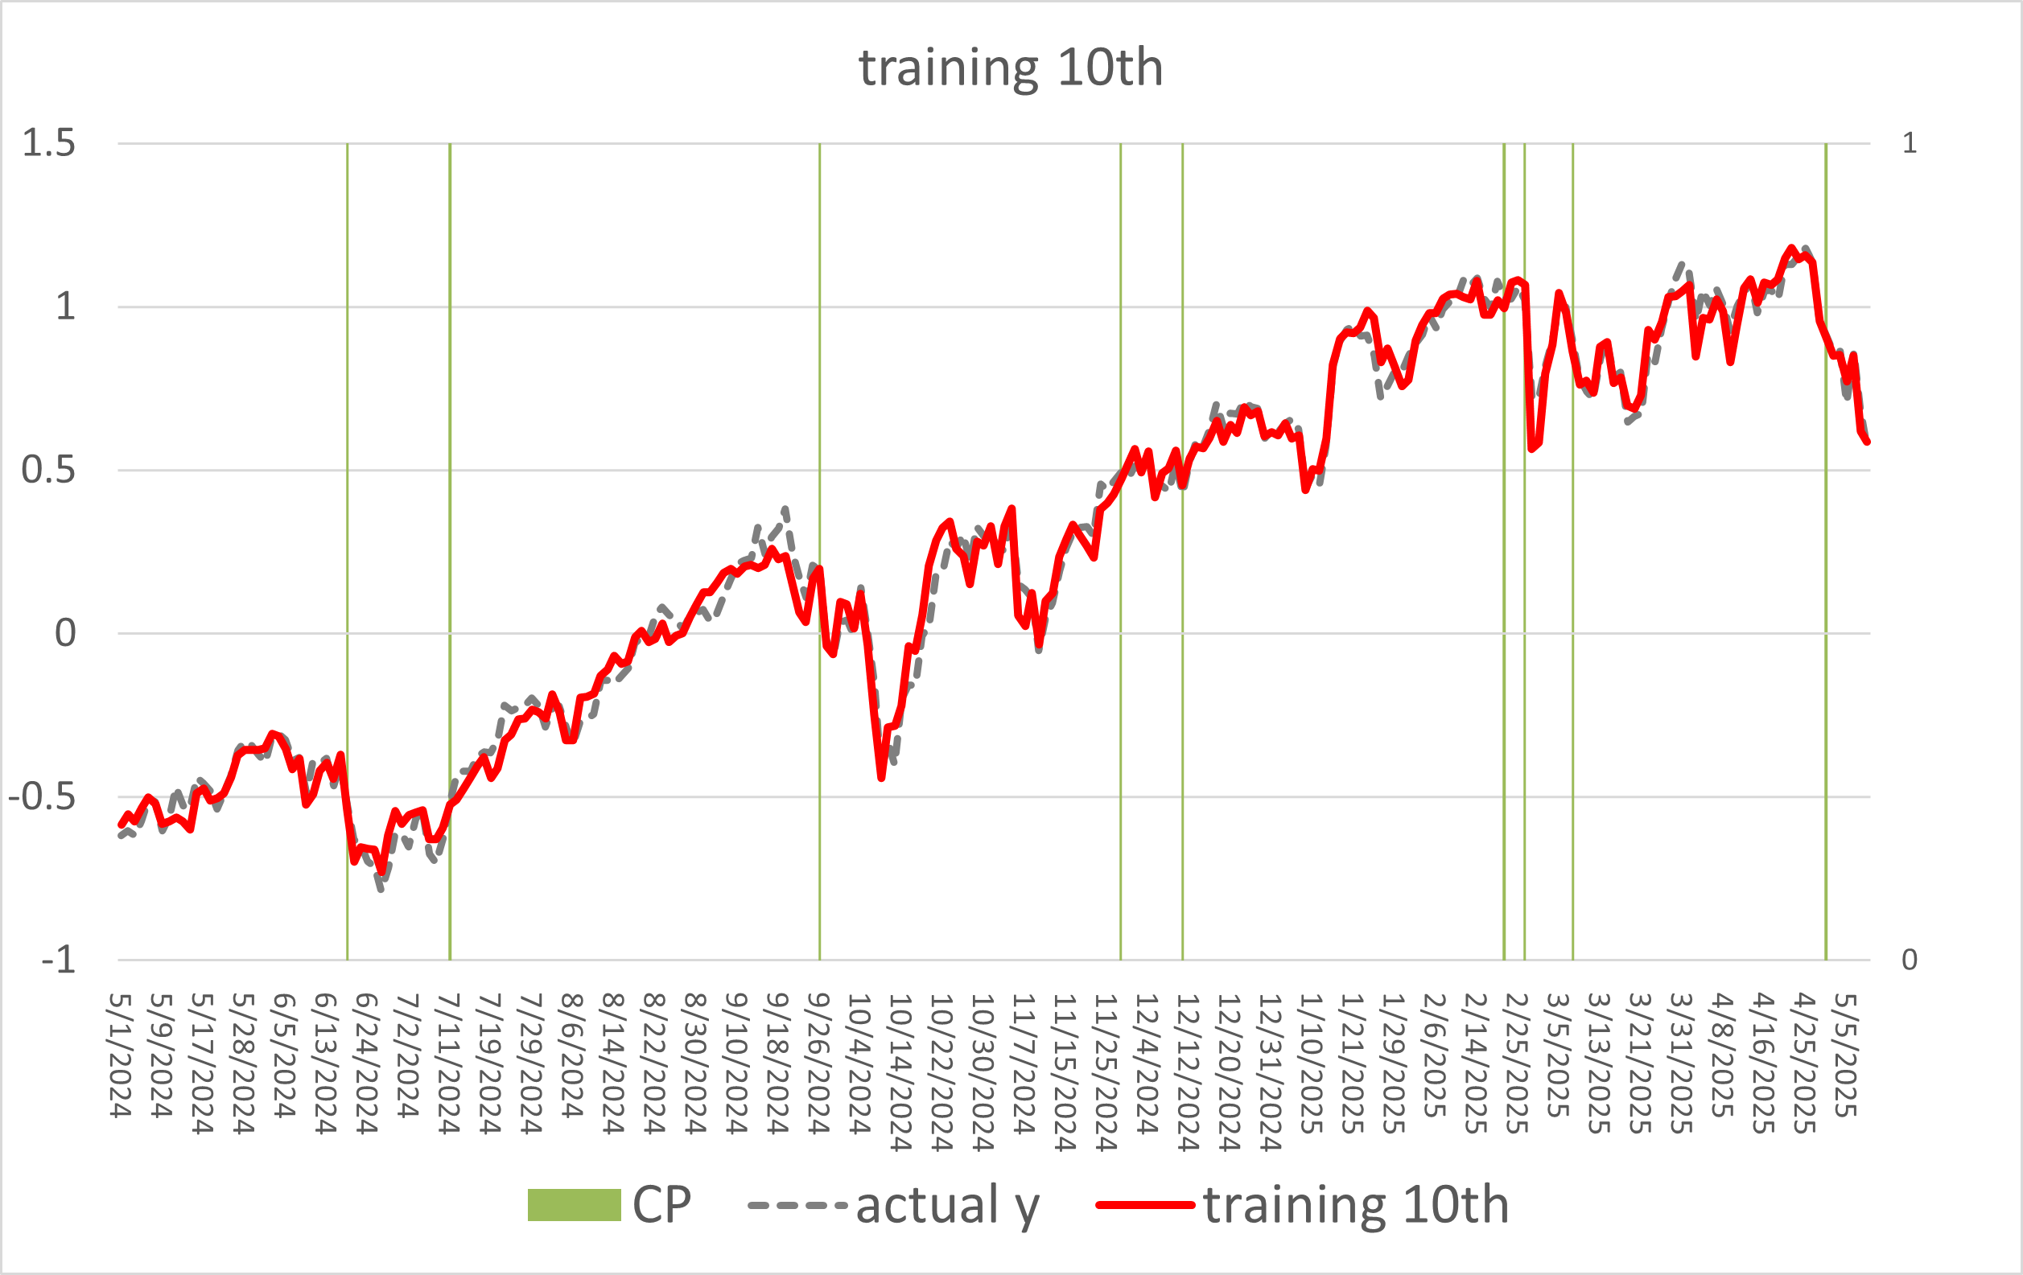
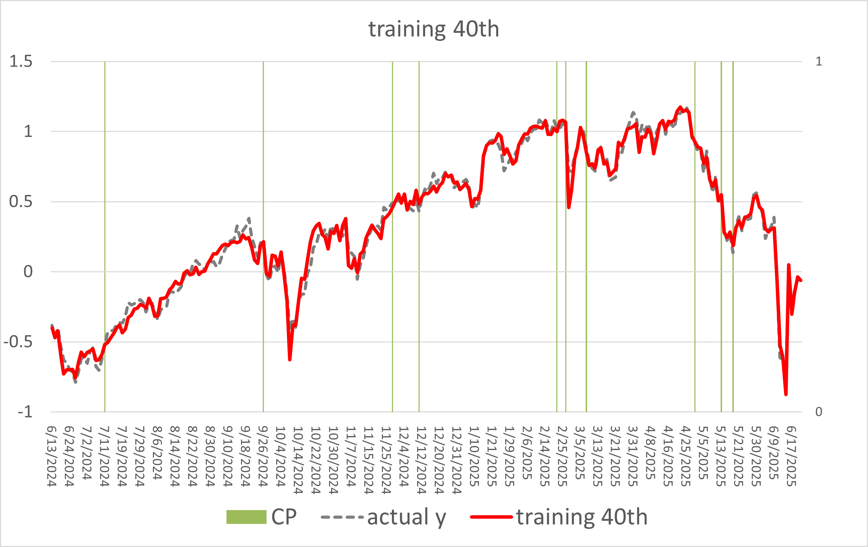
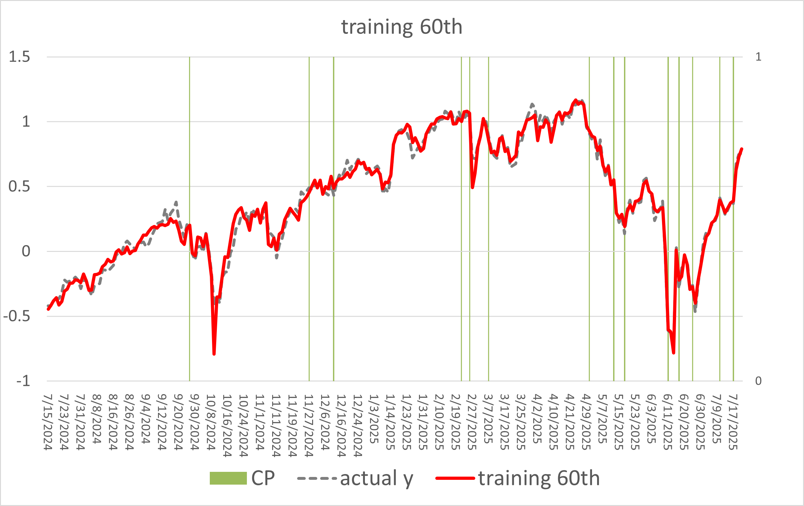
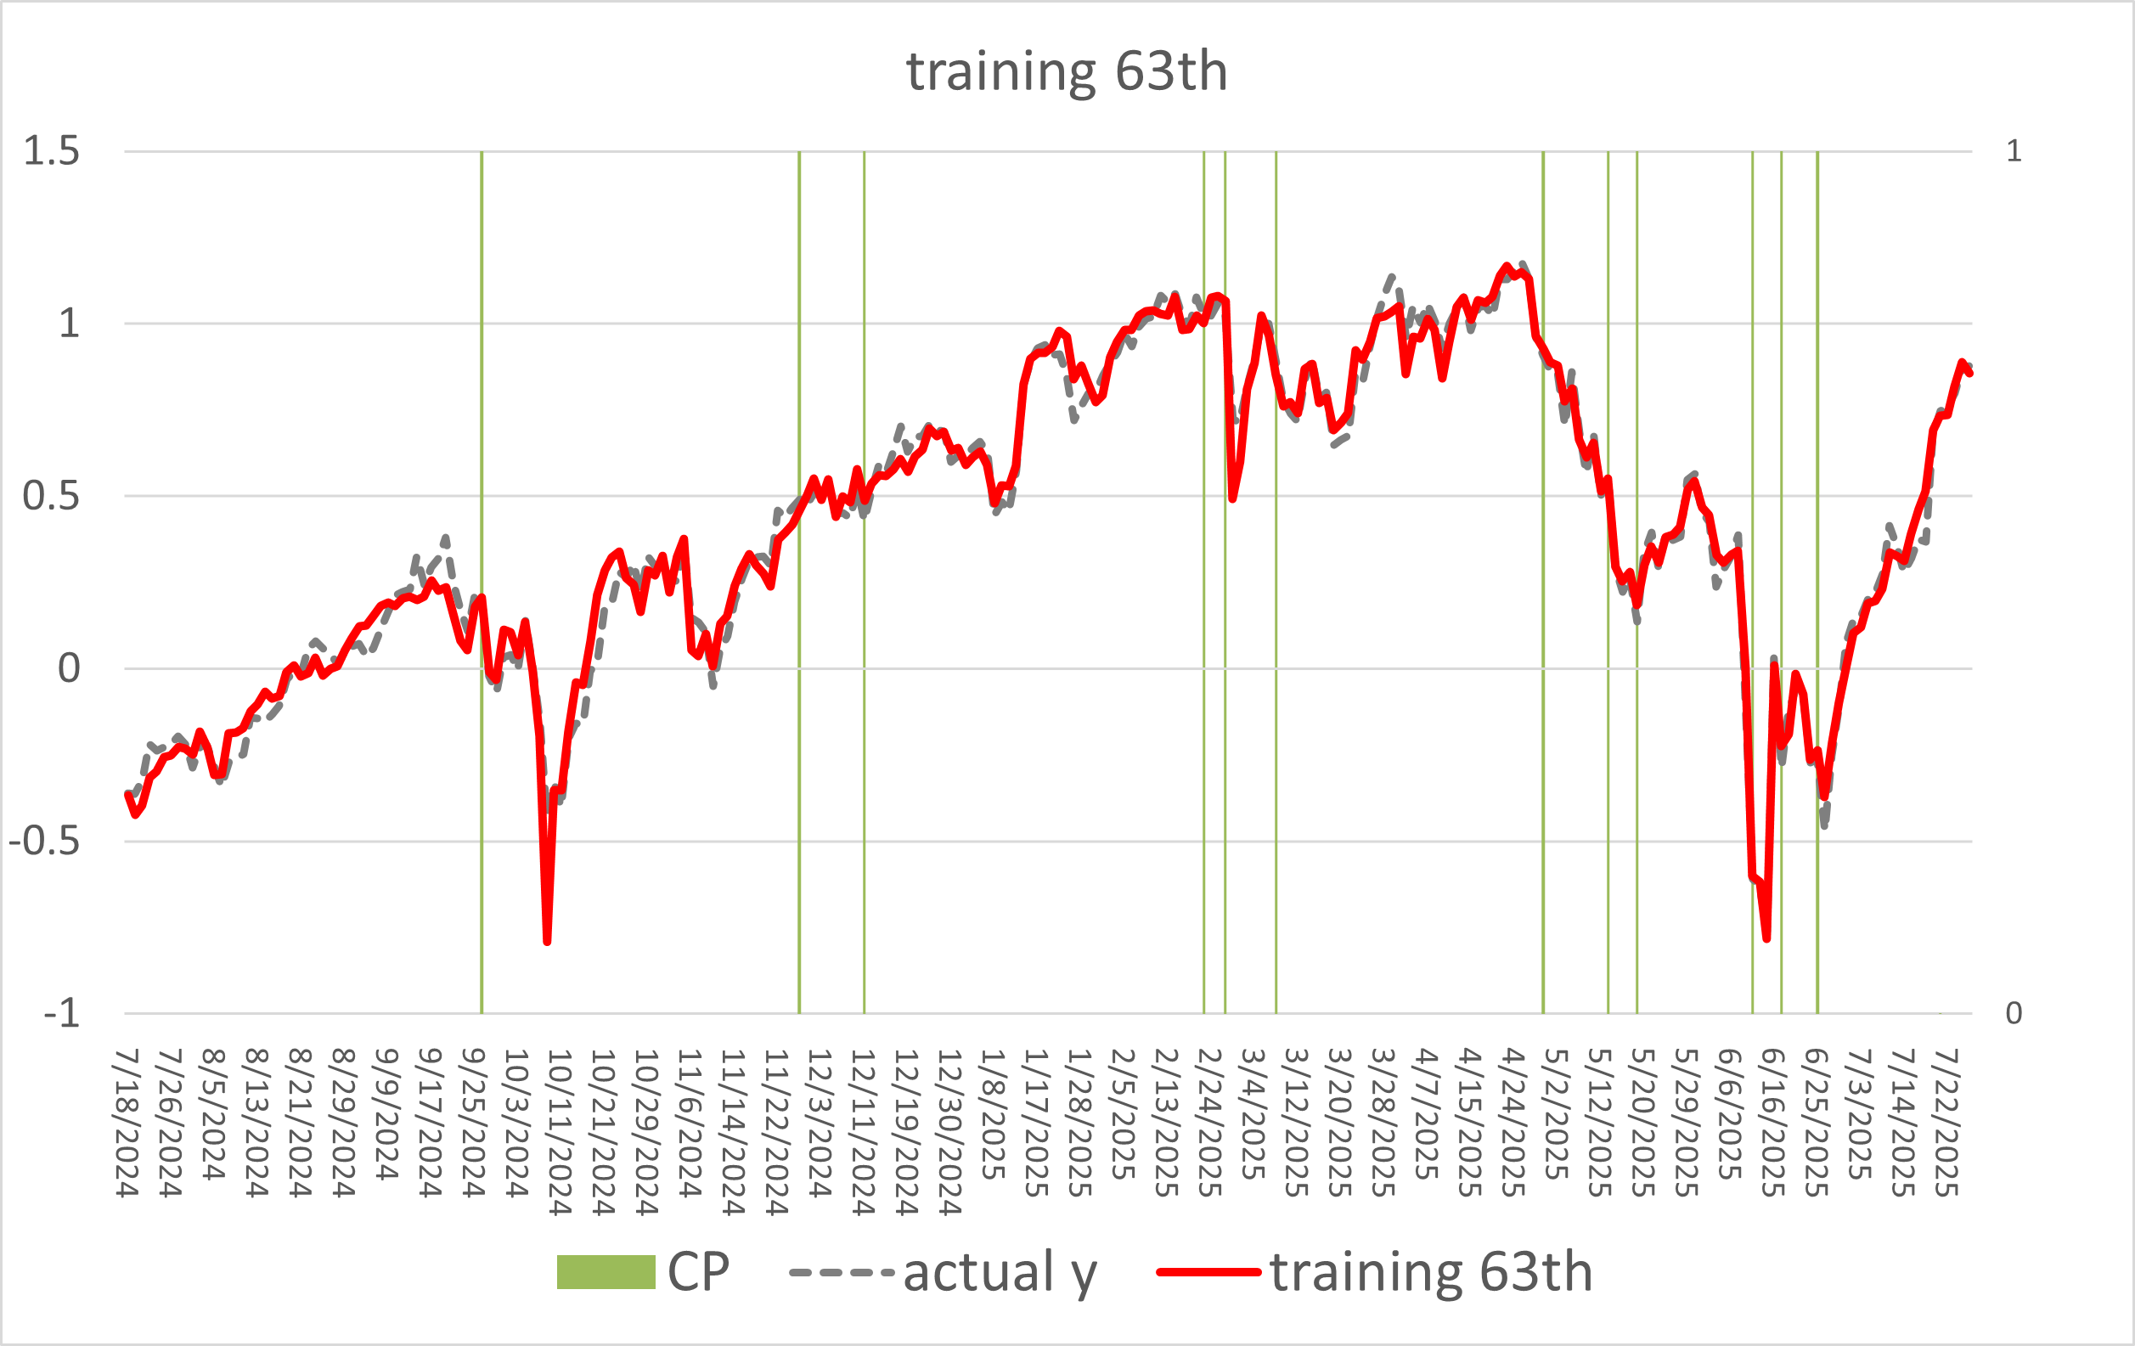
CPD Results (PSVQR-f2 tau=0.5)

Slide 20

Experiment Results (PSVQR-f2 vs PSVQR-f1)
Use 2 features
Use 1 features

Slide 21
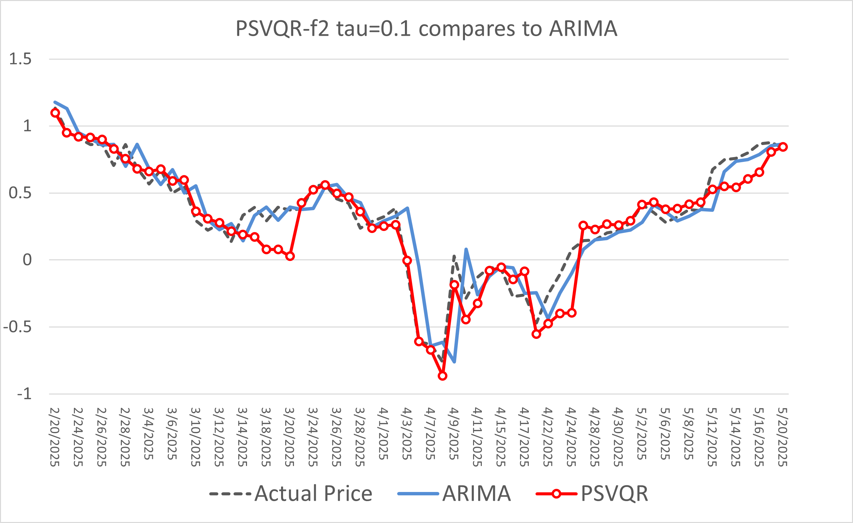
Compare to Benchmark
reciprocal tariffs

Slide 22
Conclusion
PSVQR-f2 outperforms ARIMA model in S&P 500 predictions.
Trade-off between CPD and prediction accuracy.
PSVQR has crossing quantile problem.

Slide 23
Future Work
Find a proper method to decide the penalty of CP amounts.
Solve the quantile crossing problem (e.g., Dai, Kuosmanen, & Zhou, 2023).
Transfer CPU-based solver to GPU solutions.
Add more features and compare it with other PCD methods on different datasets.

Slide 24
References
Gupta, M., Wadhvani, R., & Rasool, A. (2024). Comprehensive analysis of change-point dynamics detection in time series data: A review. Expert Systems with Applications, 123342.
Bassett Jr, G., & Koenker, R. (1982). An empirical quantile function for linear models with iid errors. Journal of the American Statistical Association, 77(378), 407-415.
Dai, S., Kuosmanen, T., & Zhou, X. (2023). Non-crossing convex quantile regression. Economics letters, 233, 111396.

Slide 25

Thanks!
Contact:
Sheng-Yu Tsai (Justin Tsai)
justintsai77@gmail.com

Slide 26

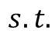
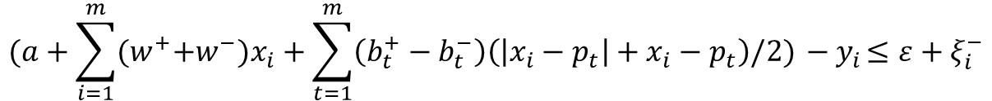
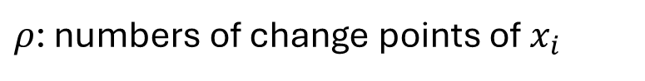
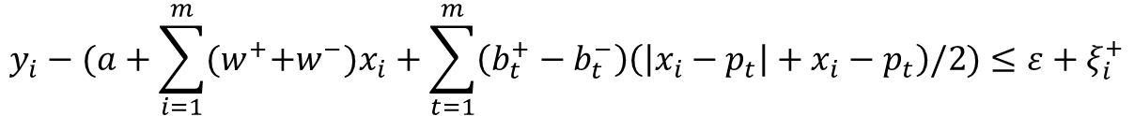
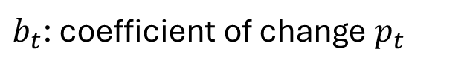
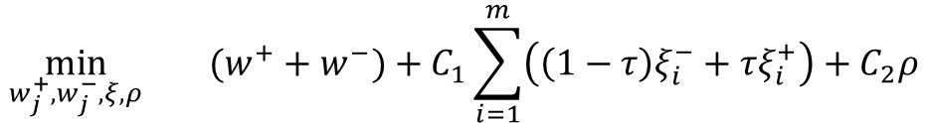
The Proposed Model
l1-norm
Quantile loss
Change Point
$$\min_{w_{j}^{+},w_{j}^{−}, ξ, ρ}{(w^{+}+w^{−})+C_{1}\sum_{i=1}^{m}{\left(\left(1−τ\right)ξ_{i}^{−}+τξ_{i}^{+}\right)}+C_{2}ρ}$$
Derived from SVR
$$y_{i}−(a+\sum_{i=1}^{m}{{{(w}^{+}+w^{−})x}_{i}}+\sum_{t=1}^{m}{\left(b_{t}^{+}−b_{t}^{−}\right)\left(\left|x_{i}−p_{t}\right|+x_{i}−p_{t}\right)\text{/2}})≤ε+ξ_{i}^{+}$$
$$s.t.$$
Piecewise Terms
$$(a+\sum_{i=1}^{m}{{{(w}^{+}+w^{−})x}_{i}}+\sum_{t=1}^{m}{\left(b_{t}^{+}−b_{t}^{−}\right)\left(\left|x_{i}−p_{t}\right|+x_{i}−p_{t}\right)\text{/2}}){ − y}_{i}≤ε+ξ_{i}^{−}$$
$w$: the hyperplane weight vector
$a$: intercept term
$m$: the size of sliding window
$ρ$: numbers of change points of $x_{i}$
$ε$: the $ε$-insensitive tube width
$b_{t}$: coefficient of change $p_{t}$
$C_{1},C_{2}$: the penalties
$ξ_{i}$: residuals outside the $ε$-insensitive tube

Slide 27
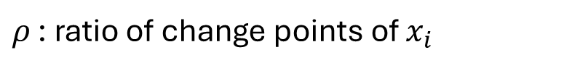
The Proposed Model
$$\min_{w_{j}^{+},w_{j}^{−}, ξ, ρ}{(w^{+}+w^{−})+C_{1}\sum_{i=1}^{m}{\left(\left(1−τ\right)ξ_{i}^{−}+τξ_{i}^{+}\right)}+C_{2}ρ}$$
$$y_{i}−(a+\sum_{i=1}^{m}{{{(w}^{+}+w^{−})x}_{i}}+\sum_{t=1}^{m}{\left(b_{t}^{+}−b_{t}^{−}\right)\left(\left|x_{i}−p_{t}\right|+x_{i}−p_{t}\right)\text{/2}})≤ε+ξ_{i}^{+}$$
$$s.t.$$
$$(a+\sum_{i=1}^{m}{{{(w}^{+}+w^{−})x}_{i}}+\sum_{t=1}^{m}{\left(b_{t}^{+}−b_{t}^{−}\right)\left(\left|x_{i}−p_{t}\right|+x_{i}−p_{t}\right)\text{/2}}){ − y}_{i}≤ε+ξ_{i}^{−}$$
$w$: the hyperplane weight vector
$a$: intercept term
$m$: the size of sliding window
$ρ$ : ratio of change points of $x_{i}$
$ε$: the $ε$-insensitive tube width
$b_{t}$: coefficient of change $p_{t}$
$C_{1},C_{2}$: the penalties
$ξ_{i}$: residuals outside the $ε$-insensitive tube

Slide 28
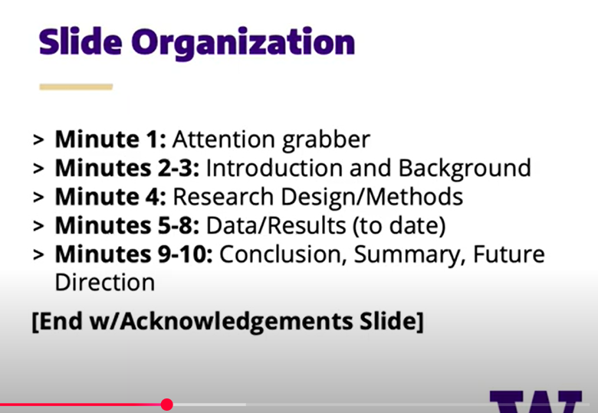

Slide 29
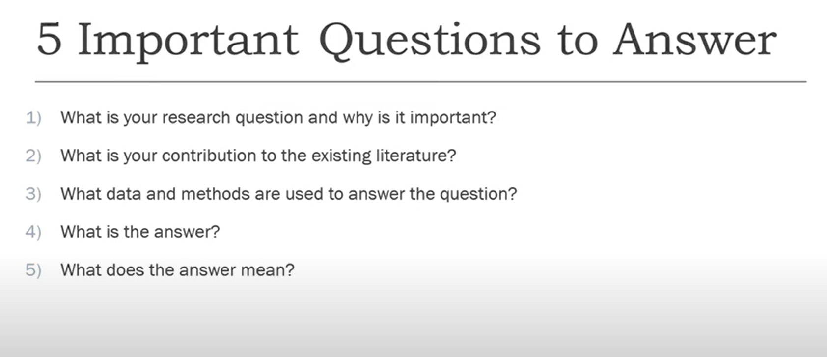

Slide 30
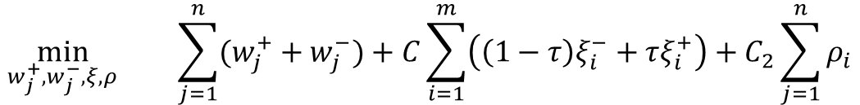
The Proposed Model
$$\min_{w_{j}^{+},w_{j}^{−}, ξ, ρ}{\sum_{j=1}^{n}{(w_{j}^{+}+w_{j}^{−})}+C\sum_{i=1}^{m}{\left(\left(1−τ\right)ξ_{i}^{−}+τξ_{i}^{+}\right)}+C_{2}\sum_{j=1}^{n}{ρ_{i}}}$$
$$y_{i}−(a+\sum_{j=1}^{n}{\left(w_{j}^{+}−w_{j}^{−}\right)x_{ij}+}\sum_{j=1}^{n}{\sum_{t=1}^{m}{\left(b_{jt}^{+}−b_{jt}^{−}\right)\left(\left|x_{ij}−p_{jt}\right|+x_{ij}−p_{jt}\right)\text{/2})}≤ε+ξ_{i}^{+}}$$
$$s.t.$$
$$(a+\sum_{j=1}^{n}{\left(w_{j}^{+}−w_{j}^{−}\right)x_{ij}+}\sum_{j=1}^{n}{\sum_{t=1}^{m}{\left(b_{jt}^{+}−b_{jt}^{−}\right)\left(\left|x_{ij}−p_{jt}\right|+x_{ij}−p_{jt}\right)\text{/2}})−y_{i}≤ε+ξ_{i}^{−}}$$

Slide 31
Why Quantile loss?
provides interval predictions by varying τ,
suitable for addressing uncertainty
effectively captures data heterogeneity
improves resilience to outliers.

Slide 32
propose a hybrid optimization approach for
automatic change-point detection and interval prediction.
Piecewise Support Vector Quantile Regression
(PSVQR)

Slide 33
Why Quantile loss?
smaller τ penalizes overestimated samples (where the true value is less than the prediction).
larger τ penalizes underestimated samples (where the true value exceeds the prediction)

Slide 34
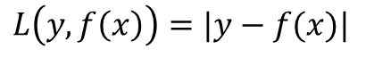
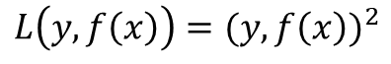
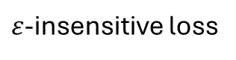
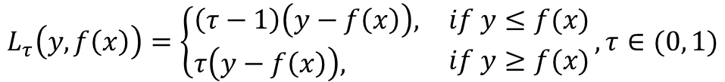
Why Quantile loss?
Absolute loss
$$L\left(y, f\left(x\right)\right)=|y−f(x)|$$
Wang, Q., Ma, Y., Zhao, K., & Tian, Y. (2020). A comprehensive survey of loss functions in machine learning. Annals of Data Science, 1-26.
Square loss
$$L\left(y, f\left(x\right)\right)={(y, f\left(x\right))}^{2}$$
Quantile loss
$$L_{τ}\left(y, f\left(x\right)\right)=\left\{\begin{aligned}&\left(τ−1\right)\left(y−f\left(x\right)\right), \\ &τ\left(y−f\left(x\right)\right),\end{aligned} {if y≤f(x) \atop if y≥f(x)},τ∈(0, 1)\right.$$
$ε$-insensitive loss
$$L_{ε}\left(y, f\left(x\right)\right)=\max{\{0, \left|y−f\left(x\right)\right|−ε\}}=\left\{\begin{aligned}&0, \\ &\left|y−f\left(x\right)\right|−ε,\end{aligned} {if \left|y−f\left(x\right)\right|≤ε \atop if \left|y−f\left(x\right)\right|>ε} ,ε>0\right.$$

Slide 35
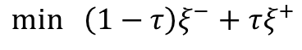

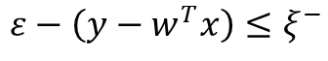
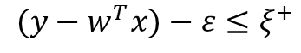
Why Quantile loss?
Adapt Quantile loss and $ε$-insensitive loss
$$\min_{}\left(1−τ\right)ξ^{−}+τξ^{+}$$
$$(y−w^{T}x)−ε≤ξ^{+}$$
$$ε−\left(y−w^{T}x\right)≤ξ^{−}$$

Slide 36
六、 相關文獻參考 (Supporting Literature)
以下是一些關於「分位數交叉」問題的經典及相關文獻，可以在您報告的 Q&A 環節或未來研究中提供支持。
Koenker, R. (2005). Quantile Regression. Cambridge University Press.
重要性： 這是分位數迴歸領域最權威的「聖經」。書中詳細討論了分位數交叉的現象及其理論基礎。引用這本書代表您對該領域有著根本性的理解。
Bondell, H. D., Reich, B. J., & Wang, H. (2010). Noncrossing quantile regression curve estimation. Biometrika, 97(4), 825-838.
重要性： 這是一篇處理非交叉問題的關鍵論文。它提出了一種在模型估計過程中就加入限制的方法，來確保不同分位數的預測線不會交叉。這篇是您提出「未來工作」方向時最有力的參考。
Takeuchi, I., & Furuhashi, T. (2005). Non-crossing quantile regression with support vector machines. 2005 SICE Annual Conference.
重要性： 這篇論文與您的研究方法高度相關。它專門探討如何在支持向量機 (SVM) 的框架下解決分位數交叉問題。在 Q&A 時若被問到您的模型該如何改進，引用這篇文獻會非常精準且具說服力。
祝您報告順利！

Slide 37
Using Piecewise Support Vector Quantile Regression
Automatic Change-Point Detection
Speaker: Sheng-Yu Tsai (Justin)
National Chi Nan University
Authors: Jing-Rung Yu¹, Sheng-Yu Tsai¹, Chun-Yen Tsai¹, Donald Lien²

